Slide 1
Digital Portfolio
STUDENT NAME: KARTHIKA M
REGISTER NO AND NMID: asbru092422k2242
DEPARTMENT: COMPUTER SCIENCE
COLLEGE: GOVERNMENT ARTS COLLEGE,UDUMALPET/BHARATHIYAR UNIVERSITY

Slide 2
PROJECT TITLE INTERACTIVE DIGITAL PORTFOLIO USING FRONT END WEB DEVELOPMENT

Slide 3


AGENDA
Problem Statement
Project Overview
End Users
Tools and Technologies
Portfolio design and Layout
Features and Functionality
Results and Screenshots
Conclusion
Github Link
3/21/2024 Annual Review

Slide 4

PROBLEM STATEMENT
1. Difficulty in showcasing skills effectively using traditional resumes.
2. Lack of an interactive platform to highlight technical projects.
3. Recruiters need a quick and clear overview of candidate capabilities.
4. Many portfolios lack modern design and mobile responsiveness.
5. Need for a personalized website to present skills, projects, and contact details.

Slide 5

PROJECT OVERVIEW
1. A personal portfolio website for showcasing skills and projects.
2. Built using HTML, CSS, and JavaScript with a modern design.
3. Highlights expertise in programming and data analytics.
4. Provides easy navigation and contact details for recruiters.

Slide 6

WHO ARE THE END USERS?
1. Students who want inspiration for their own portfolios.
2. Friends and family to view personal achievements.
3. Clients looking for technical expertise.
4. Networking contacts in the data analytics field.

Slide 7
TOOLS AND TECHNIQUES
1. HTML5 – for creating the structure of the portfolio.
2. CSS3 – for styling with modern layouts and colors.
3. JavaScript – for adding interactivity.
4. CodePen Editor – for writing, testing, and previewing code online.

Slide 8
POTFOLIO DESIGN AND LAYOUT
1. Header with Menu Bar – contains name, role, and navigation links.
2. About Section – short description highlighting background and skills.
3. Skills Section – displays technical expertise in programming and data analytics.
4. Projects Section – showcases selected projects with descriptions.
5. Contact Section – provides phone number, email, and easy reach options.
8

Slide 9
FEATURES AND FUNCTIONALITY
1. Responsive Design – works smoothly on desktop and mobile.
2. Navigation Menu – easy movement between sections.
3. About Section – presents a quick personal introduction.
4. Skills Showcase – highlights technical expertise clearly.
5. Projects Display – lists sample projects with descriptions.
6. Contact Info – provides phone number and email for communication.
7. Modern Theme – clean two-color design for a professional look.

Slide 10
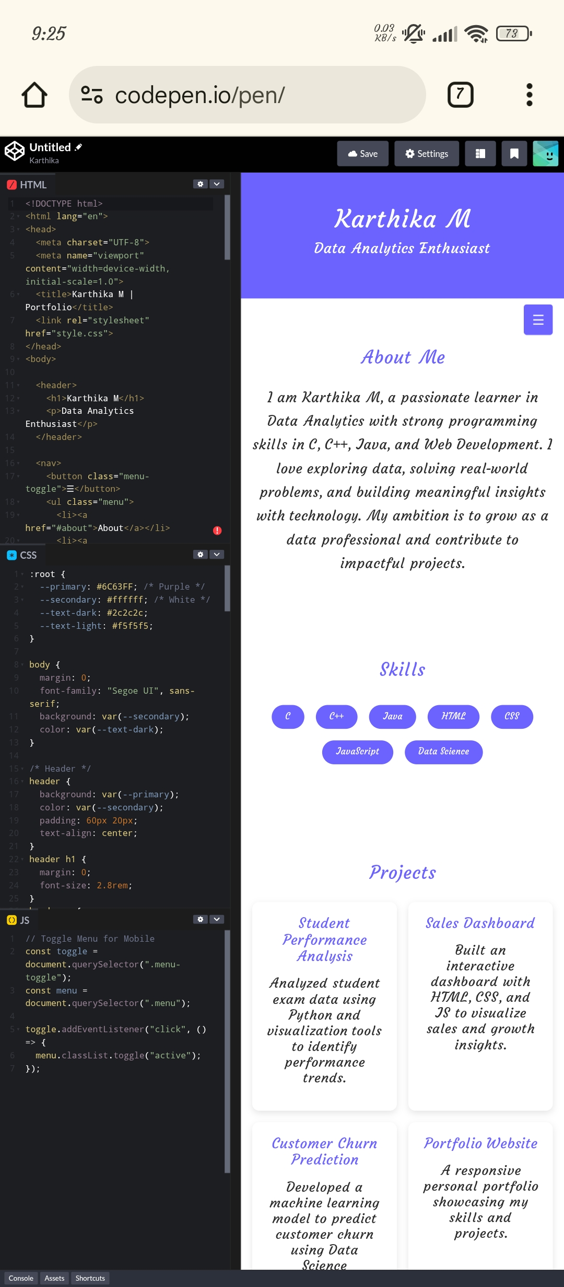

RESULTS AND SCREENSHOTS
3/21/2024 Annual Review
10

Slide 11
CONCLUSION
1. The project successfully showcases personal skills and projects.
2. A modern and responsive design improves professional presentation.
3. Easy navigation allows recruiters to quickly access details.
4. The portfolio highlights expertise in programming and data analytics.
5. It serves as a professional platform for career opportunities.
11

